Slide 1



Smart Agriculture Pest Detection
A Mist-Fog-Assisted Real-Time Framework Using Deep Transfer Learning
Candidate: Sujeet Kumar (Roll No. 44)
Supervisor: Dr. Dilip Senapati
Department of Computer Science
University of Delhi

Slide 2
Introduction
Revolutionizing Farming with Smart Agriculture 4.0

Slide 3






The Agricultural Crisis
Global Yield Loss
Bandwidth Barriers
The Latency Wall
Pests and pathogens account for nearly 30% of annual crop yield losses globally, threatening food security.
High-resolution visual data creates "data storms" that saturate rural networks in purely cloud-centric models.
Real-time detection requires localized processing to ensure immediate actuation (e.g., localized spraying).

Slide 4
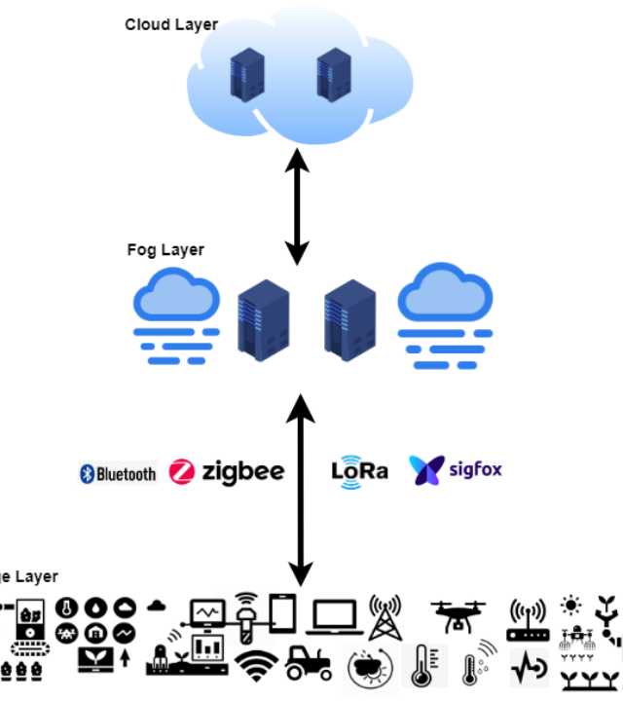
System Architecture
Mist-Fog-Cloud Hierarchy
Our decentralized framework distributes the computational load across three specialized layers to ensure responsiveness and stability.
By moving "Cognitive" tasks to the Fog layer and "Reflexive" tasks to the Mist layer, we optimize both speed and accuracy.

Slide 5



Distributed Intelligence
Mist Node
Fog Node
Cloud Tier
Raspberry Pi 4 Handles image acquisition, noise reduction, and initial TFLite detection.
Local Server Performs high-fidelity classification using full DINOv2-ViT model (15ms latency).
Remote Analytics Manages long-term storage, migration pattern mapping, and model retraining.

Slide 6

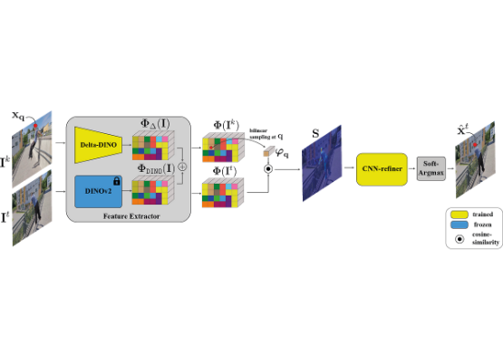
DINOv2: The Vision Transformer
Self-Supervised Feature Extraction
vits14 Backbone: Segments images into 14x14 pixel patches for global context.
Fine-Grained Classification: Distinguishes 132 pest categories in the Pestopia dataset.
Label Smoothing (0.1): Improves generalization on unseen test samples.

Slide 7


Intelligent Offloading Logic
M/M/1/K Queuing Theory
To prevent system overflows during pest "bursts", we employ Markov Modulated Poisson Process (MMPP).
32%
Offloaded Frames
This dynamic calculation ensures a stable monitoring rate of 10 FPS.

Slide 8
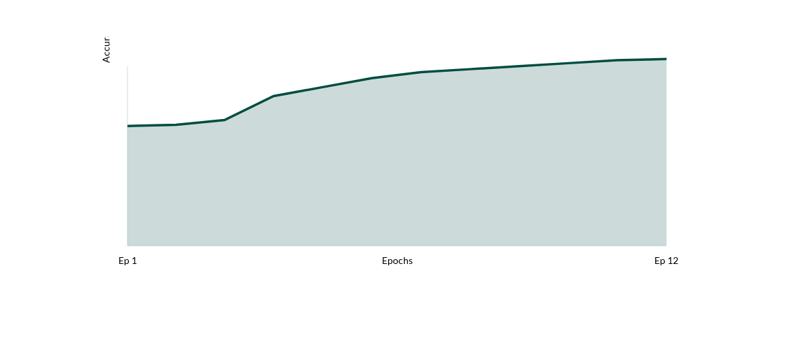
Training Accuracy (Pestopia Dataset)
Validation accuracy peaked at 76.5% following the Stage 2 Fine-tuning transition.

Slide 9
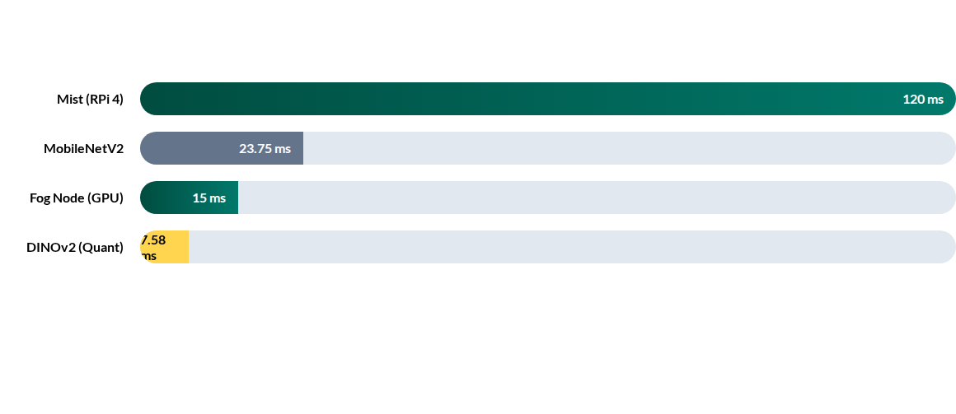
Latency Comparison (ms)
Fog-layer processing provides an 8x speedup over localized Raspberry Pi inference.

Slide 10
Model Performance Metrics
Metric | MobileNetV2 (Baseline) | DINOv2-S (Proposed) | Improvement
Top-1 Accuracy | 63.4% | 72.1% | +13.7%
Macro F1-Score | 0.61 | 0.71 | +16.4%
Inference Latency | 23.75 ms | 7.58 ms (Quantized) | +68.1%
Model Size | 37.3 MB | 12.23 MB | +67.2%

Slide 11

Conclusion & Future Directions
The Next Frontier
Blockchain Integration: Ensuring data sovereignty and a verifiable audit trail for pest outbreaks.
Summary
Decentralized computing successfully solves the "Bandwidth Wall" problem in rural IoT.
Mobility-Aware AI: Adaptive offloading for autonomous tractors and UAV swarms.
The DINOv2 backbone achieves high-resolution understanding of 132 pest species with superior efficiency.

Slide 12
Thank You!
Questions & Discussion
Candidate: Sujeet Kumar
Supervisor: Dr. Dilip Senapati
University of Delhi | Department of Computer Science

Slide 13



Image Sources
https://oldimg.emirates247.com/polopoly/images/2012/07/30/469429.gif
Source: www.emirates247.com
https://encyclopedia.pub/media/item_content/202109/cloudfogedgesmartagriculture-6154309d8ad0a.png
Source: encyclopedia.pub
https://miro.medium.com/v2/resize:fit:1200/0*ud4YfBHblHSlpvXP.png
Source: blog.stackademic.com

